Slide 1
Arrays: Outline
Sorting arrays
Multi-dimensional arrays

Slide 2
Selection Sort
Consider arranging all elements of an array so they are ascending order
Algorithm is to step through the array
    Place smallest element in index 0
    Swap elements as needed to accomplish this
Called an interchange sorting algorithm

Slide 3
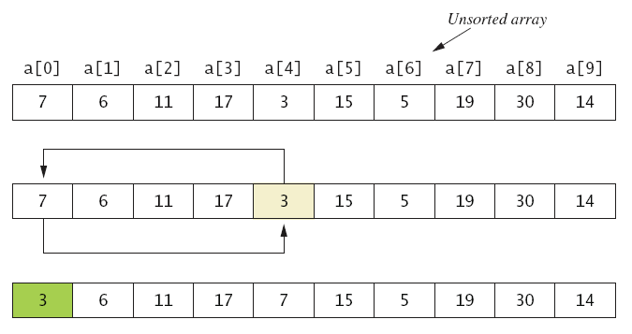
Selection Sort

Slide 4
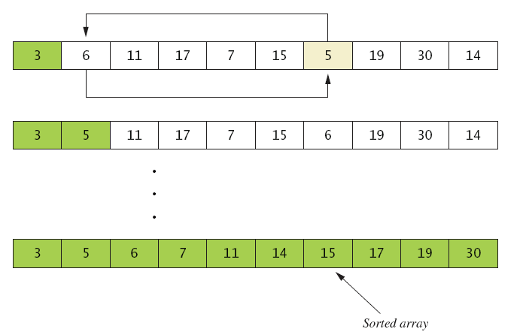
Selection Sort
. . .

Slide 5
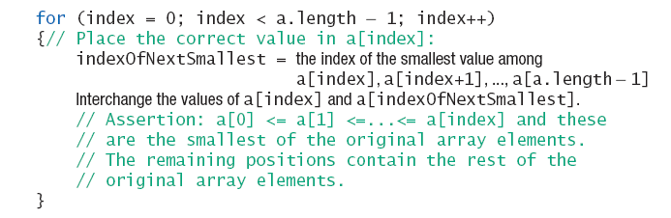
Selection Sort
Algorithm for selection sort of an array

Slide 6
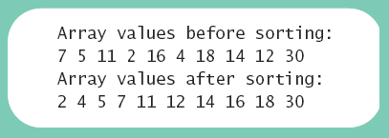
Selection Sort – output
Sample
screen output

Slide 7
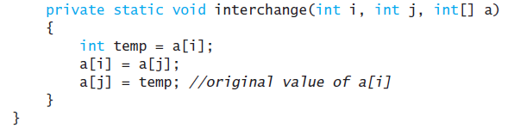
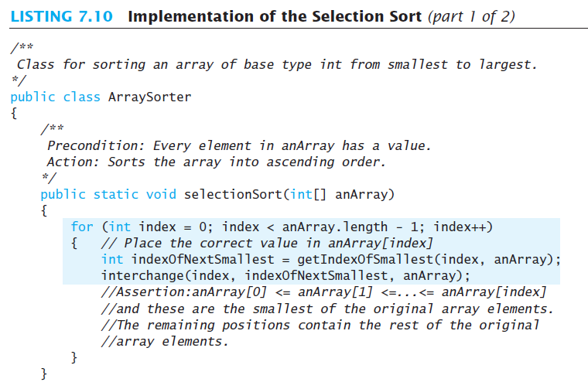
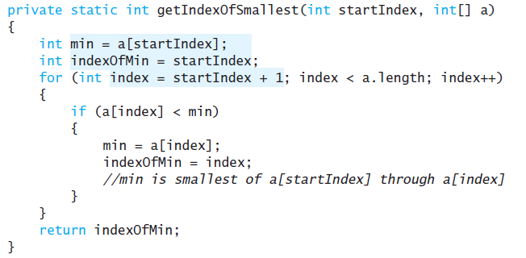
Selection Sort – code

Slide 8
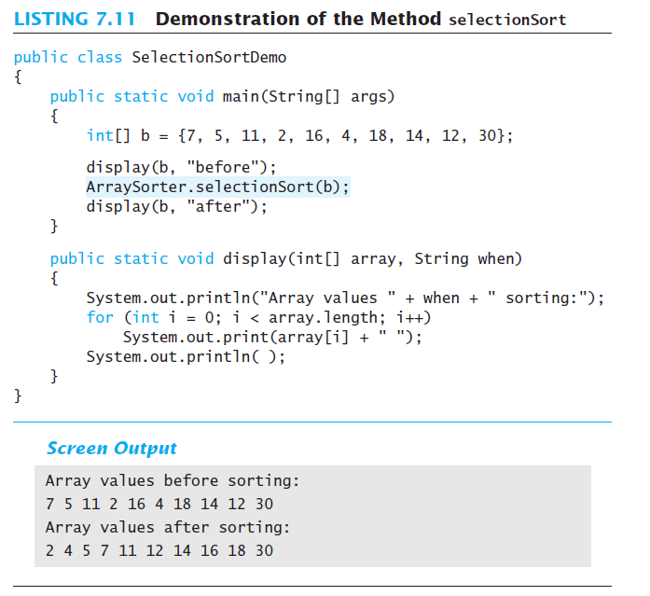

Slide 9
Other Sorting Algorithms
Selection sort is simplest
  But it is very inefficient for large arrays
Java Class Library provides for efficient sorting
  Has a class called Arrays
  import java.util – Arrays.sort(int [])

Slide 10
Searching an Array
Sequential search
  Looks in order from first to last
  Good for unsorted arrays
Search ends when
  Item is found … or …
  End of list is reached
If list is sorted, use more efficient searches

Slide 11
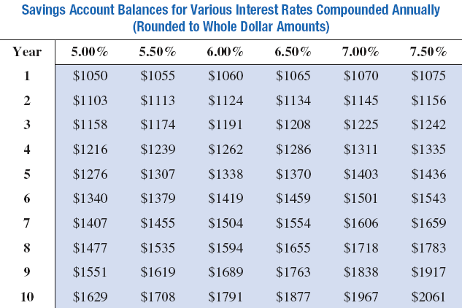
Multidimensional-Array Basics

Slide 12
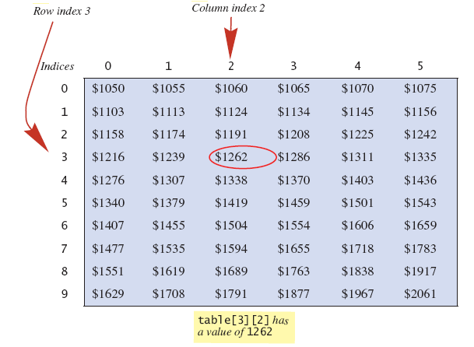
Multidimensional-Array Basics
table[3][2] has a value of 1262

Slide 13
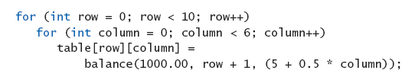
Multidimensional-Array Basics
We can access elements of the table with a nested for loop
Example:

Slide 14
Multidimensional-Array Parameters and Returned Values
Methods can have
  Parameters that are multidimensional-arrays
  Return values that are multidimensional-arrays

Slide 15
Java's Representation of Multidimensional Arrays
Multidimensional array represented as several one-dimensional arrays
Given
int [][] table = new int [10][6];
Array table is actually 1 dimensional of type int[]
  It is an array of arrays
Important when sequencing through multidimensional array

Slide 16
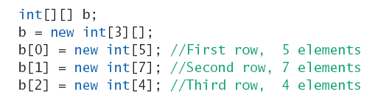
Ragged Arrays
Not necessary for all rows to be of the same length
Example:

Slide 17
Programming Example
Employee Time Records
  Two-dimensional array stores hours worked
    For each employee
    For each of 5 days of work week
  Array is private instance variable of class

Slide 18
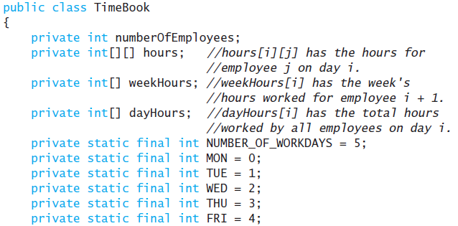
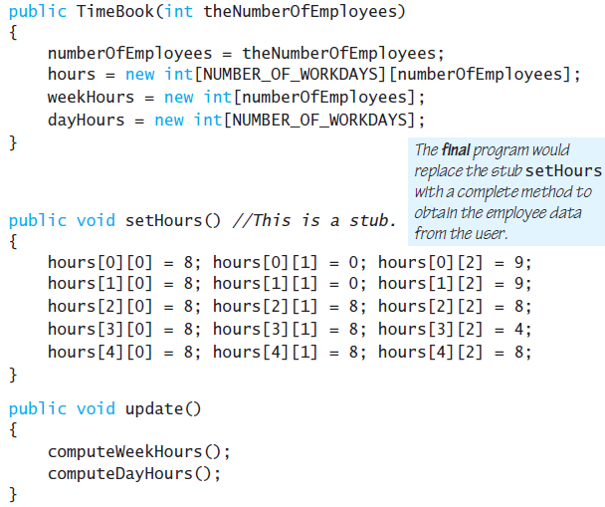
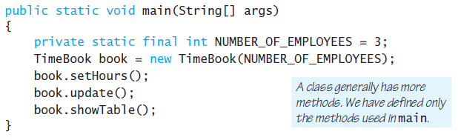
Programming Example

Slide 19
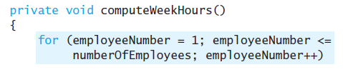
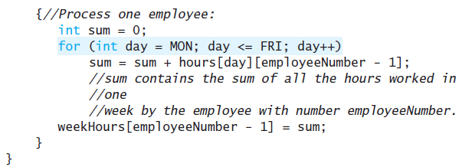
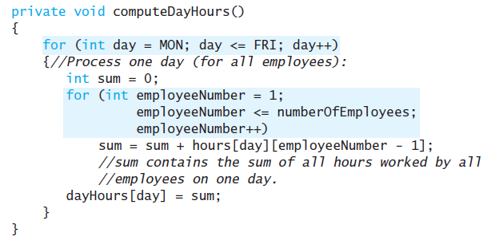

Slide 20
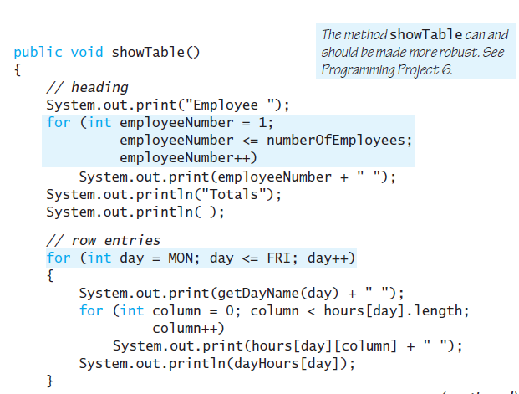

Slide 21
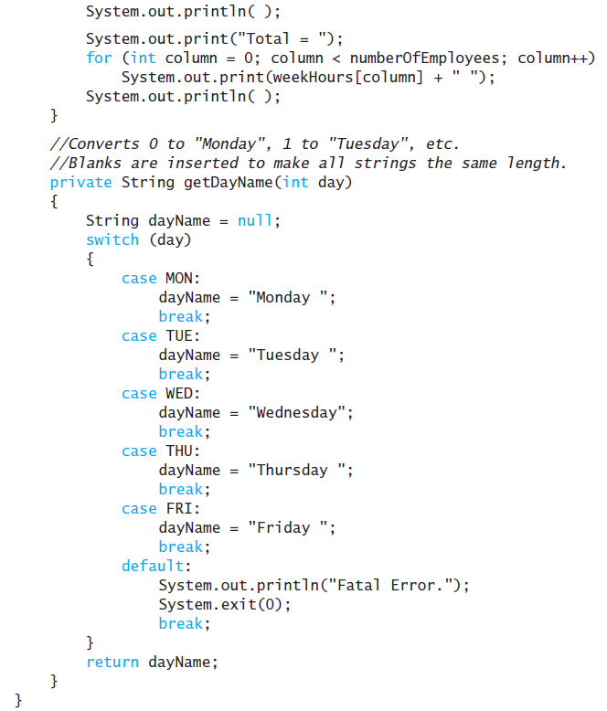

Slide 22
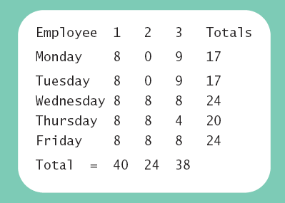
Programming Example
Sample
screen output

Slide 23
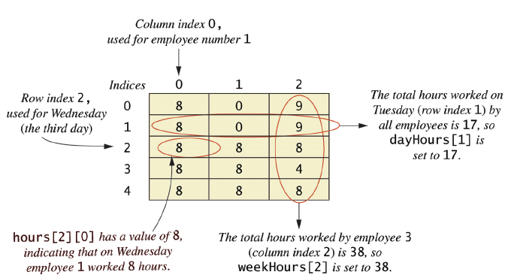
Programming Example
Arrays for the class TimeBook

